Slide 1
Small Alkyl-Alcohol Biofuels from Amino Acids
PMID: 18172501
Notes:
Small reduced hydrocarbons such as butanol have been pursued for biofuel applications with great intensity for the past few years. Butanol in particular has received major attention.

Slide 2
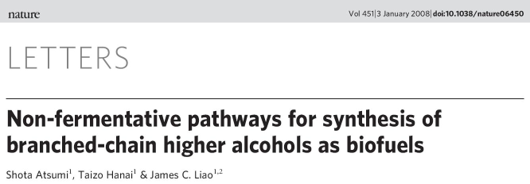
Notes:
In this paper, Liao and coworkers demonstrate an alternate pathway for butanol and related compounds by rerouting of amino acid biosynthesis intermediates.

Slide 3
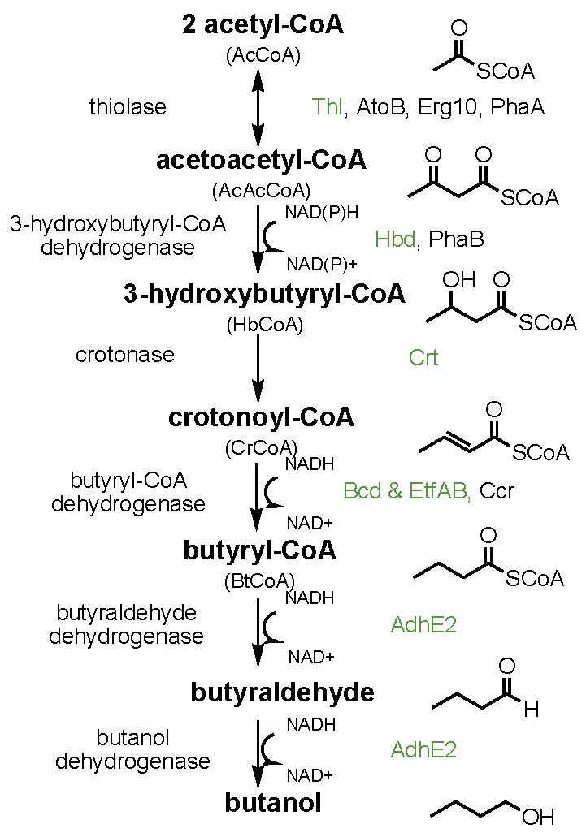
Several paths to butanol
Pathway from Clostridium acetobutylicum;
similar pathway in polyhydroxyalkanoate biosynthesis
Also see PMID: 21358636
Notes:
The more typical route to n-butanol uses enzymes from a Clostridium butyrate pathway to generate buyryl-CoA. First *click* two molecules of acetyl-coA undergo a claisen condensation to generate acetoacetyl-coA. This 4-carbon intermediate is reduced to the alcohol, then eliminated to the alkene, then reduced to the saturated butanoate chain. This sequence is very similar to the steps involved in fatty acid synthase production of larger alkyl chains. An enzyme from another organism performs the last step in which the thioester is reduced twice with NADPH to the alcohol.

Slide 4
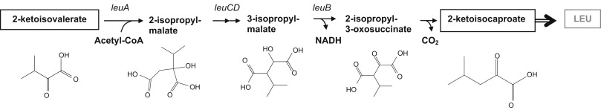


Leucine Biosynthesis
Decarboxylation
Reduction
Notes:
Atsumi instead branches off of amino acid biosynthesis. They recognized that in many amino acid biosynthetic pathways there is an *click* alpha-keto acid intermediate, including those for amino acids with short alkyl side chains. *click* Decarboxylation of this species would generate the aldehyde, and reduction would lead to short-chain alcohol.

Slide 5
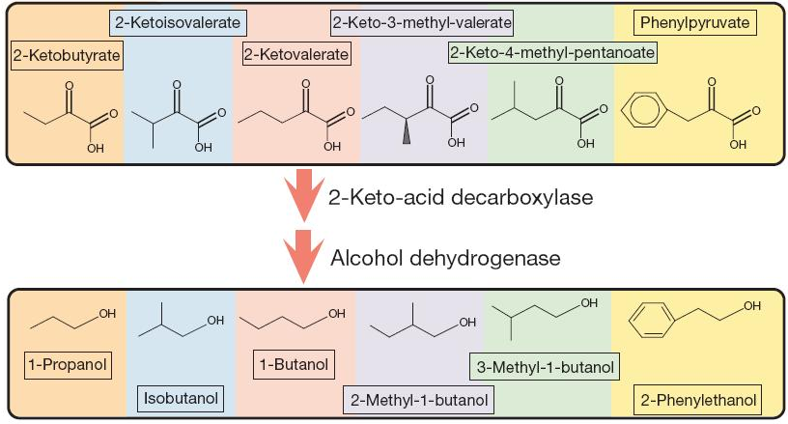
Notes:
They are able to branch off of six alpha-keto acid intermediates to generate these six different alcohols. Notice that 2 different isomers of butanol including the same one in the Clostridium pathways are generated.

Slide 6
2-keto-acid decarboxylases
alcohol dehydrogenase 2
pdc6
adh2
aro10
S. cerevisiae
S. cerevisiae
thi3
2-Ketoisovalerate Device
S. cerevisiae
ilvI
ilvH
ilvC
ilvD
kivD
PLlacO1
Lactococcus lactis
alsS
Clostridium acetobutylicum
pdc
Knockouts:
adhE, ldhA, frdAB, fnr, pta, and pflB
Notes:
To perform these two transformations (first to decarboxylate the acid and then reduce the alcohol) they needed to identify a 2-keto-acid decarboxylase and a dehydrogenase. The dehydrogenase step is no different than the one encountered in the butyryl-coA-based pathway since this aldehyde species is the penultimate step in that path as well. So, all they must identify is the decarboxylase. They choose 5 different ones from different organisms, put that into E. coli along with adh2, and successfully observe formation of isobutanol. kivD from Lactococcus works the best. *click* They also find that overexpressing a second copy of the first few steps of leucine biosynthesis improves production. They also examine an alternate route to 2-ketoisovalerate from B. subtilis encoded by AlsS and observe a slight further improvement in production. *clicK* Finally, they examine a series of chosen gene knockouts in adhE, IdhA, frdAB, fnr, pta, and pflB. These genes normally divert flux from pyruvate to generate acetate or lactate far upstream of the 2-ketoisovalerate pathway. Through this process, they were able to identify combinations of added genes and removed genes that take them within 86% of the theoretical maximum efficiency.

Slide 7
Look up the structures of the various compounds described in this study, and look up what reactions they are involved in
How were the various enzymes introduced into E. coli identified?
What sort of modifications to regulation did they make? What mechanisms of regulation did they not address that maybe could improve yield?
What is kdc and what is the reaction that it catalyzes?
What are the oxidation state changes in this conversion?
What do the ilv genes to make 2-ketoisovalerate do?
What do the genes they knocked out do? Why do they increase production?
What modifications do they make to synthesize 1-butanol?
What about toxicity?

Slide 8
Kinetic Trap in Butanol Biosynthesis
PMID: 21358636
Notes:
When choosing the enzymes for a biosynthetic pathway, it is not only the sequence of intermediates that determines the efficiency of the device. For example, the enzymes might express poorly or be toxic to the cell. Additionally, subtle differences in substrate preference and the kinetics of each step can have dramatic effects on productivity.

Slide 9
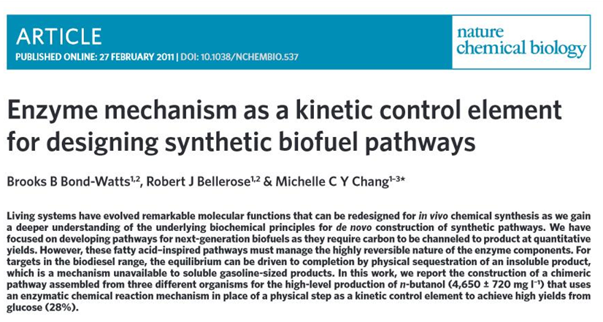
Nat Chem Biol. 2011 Apr;7(4):222-7.
Notes:
In this butanol biosynthesis study, Chang and coworkers examine hybrid butanol pathways and identify more efficient routes by careful consideration of the substrate specificity of each enzyme and the thermodynamic parameters of each step.

Slide 10
Several paths to butanol
Pathway from Clostridium acetobutylicum;
similar pathway in polyhydroxyalkanoate biosynthesis
Also see PMID: 21358636
Notes:
The most common route to n-butanol is based on the Clostridium pathway for butyric acid. This route starts with *click* acetyl-CoA but goes through this *click* alcohol intermediate. *click* *click*

Slide 11
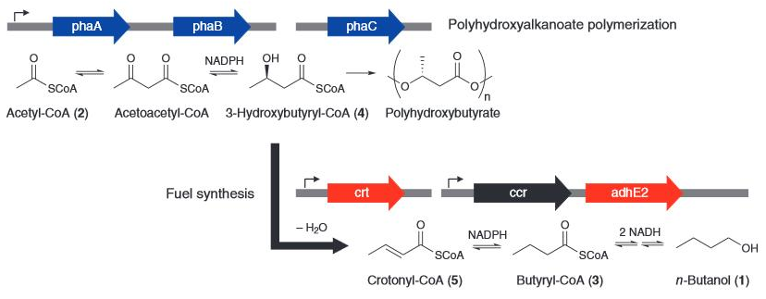
Chang Butanol Pathway
Notes:
They noted that a similar sequence of intermediates were produced during this 3-enzyme polyhydroxybutyrate pathway from Ralstonia eutrophus. If they only took *click* phaA and phaB from this pathway, they’d reach the 3-hydroxybutyryl-coA intermediate also in the Clostridium-based butanol pathway. Thus, by *click* combining these two genes with the downstream genes from the clostridium-derived path, they’d reconstitute a very similar pathway to n-butanol. This was the first hybrid pathway they describe called Bu1.

Slide 12
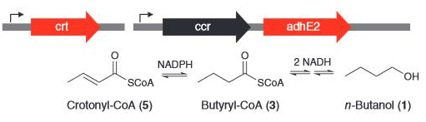
Crotonyl-CoA Reduction
Notes:
Through a series of observations, they conclude that ccr is the slow step in the pathway. Thus, there is a bottlneck at Crotonyl-CoA that limits butanol production. They also note that the reduction is reversible. Closer inspection of the biochemistry of this enzyme and alternates reveals that most enzymes one might choose for this reduction step employ a flavin mediator. The free energy for reduction with a flavin is closer to zero than reduction with NADPH. Thus, if they used an enzyme that was entirely flavin independent this step would be irreversible. They identify such an enzyme from Treponema called Ter and swap out Ccr with it.

Slide 13
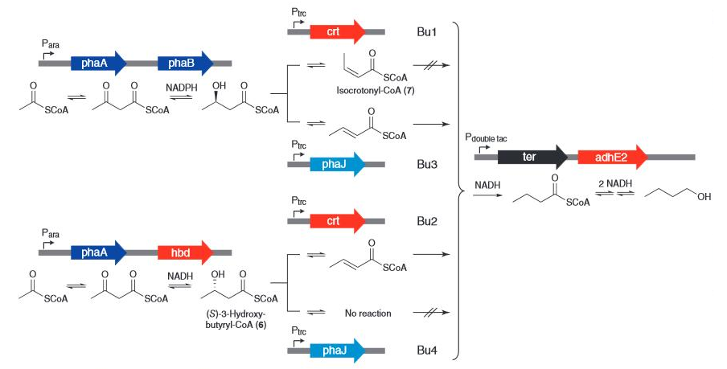
Chang Butanol Pathway
Notes:
When they exchange ter for ccr, with the Bu1 combination of phaA, phaB and crt (the top-most route in this figure), they observe poor yield and investigate alternative genes at the reduction and dehydration steps.
For the NADH reduction step encoded by phaB, they could use the Clostridium enzyme in red, hbd, or the Ralstonia enzyme phaB in blue. Similarly in the subsequent elimination step, they could use either source organism with crt or phaJ respectively. They find that only the Bu2 and Bu3 combinations (the middle two routes) give high yield. The explanation for the differences deal with subtle aspects of enzyme specificity. OhaB and hbd reduce acetoacetyl-coa from opposite sides. PhaB produces the *click* R entantiomer, and Hbd produces *click* S. In the next step, dehydration of the alcohol to an alkene can result or a cis or trans isomer. PhaJ only accepts the R enantiomer and generates the trans product, while crt will accept either intermediate and generates cis or trans based on the stereochemistry of the alcohol. The next step, reduction with ter, only works for the trans intermediate. Thus, combination of hbd and phaJ results in no product. If you use crt with the R intermediate, the alkene intermediate is formed, but it is not a substrate for ter. By virtue of these subtle differences in substrate preference, dramatic differences in production rates are observed for the 4 different combinations. The off-species combinations give poor yield, and the on-species ones produce comparable high-yield. This paper demonstrates how very subtle differences in substrate specificity and the free energy of critical steps can dramatically affect the productivity of a pathway.

Slide 14
Bioremediation of Perchlorinated Biphenyls
PMID: 15870360
Notes:
One of the major application areas for metabolic engineering is bioremediation. In such systems, the bacterium chemically degrades some unwanted chemical. In this study, the authors are trying to degrade perchlorinated biphenyls. These compounds were used extensively in electronics until 1979 when they were banned due their tendency to cause cancer and persist in the environment.

Slide 15
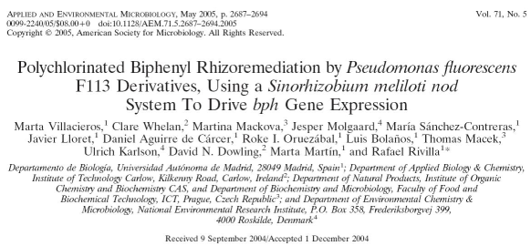
Appl Environ Microbiol. 2005 May;71(5):2687-94.
Notes:
In this study, Rivilla and coworkers seek to engineer a bacterium that normally colonizes the roots of plants with the genes for a catabolic device for perchlorinated biphenyls.

Slide 16
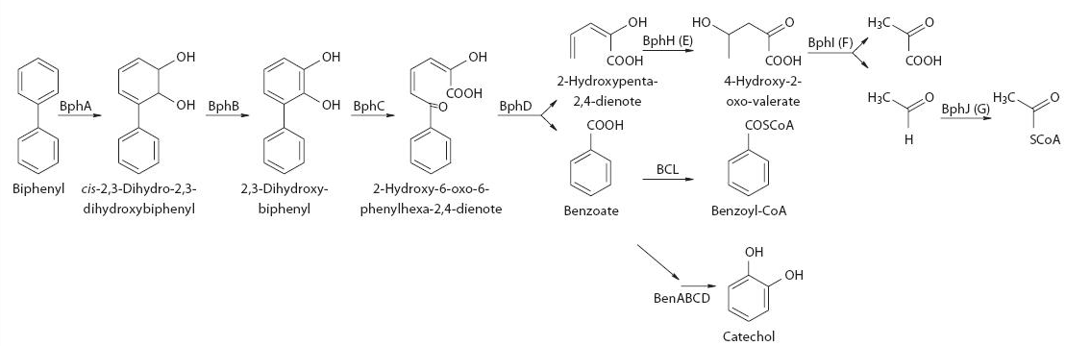
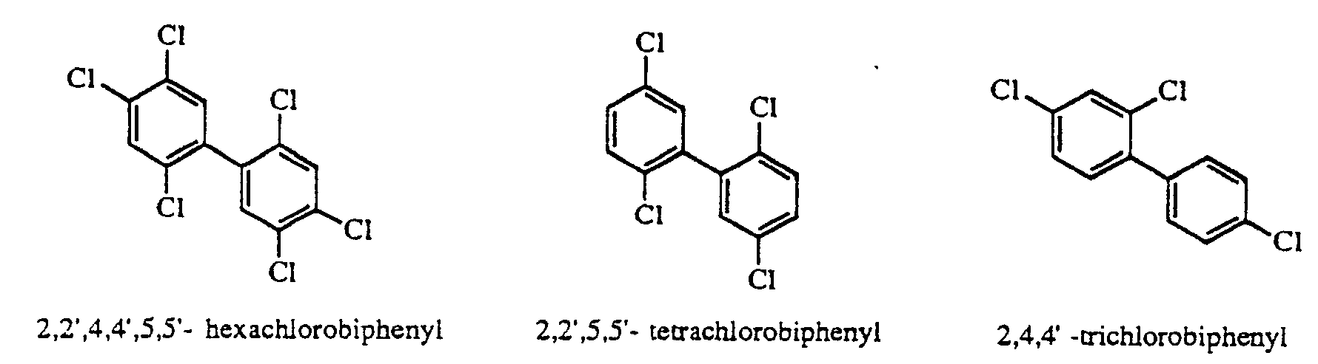
Biphenyl Catabolism
From Burkholderia sp. Strain LB400
Notes:
They employ a pathway from Burkholderia that can degrade biphenyl to innocuous primary metabolites. Though the actual substrates they wish to degrade are *click* these sorts of chlorinated derivatives, it turns out that this pathway is fairly promiscuous, and a wide variety of PHBs get degraded through this *click* dienoate intermediate.

Slide 17
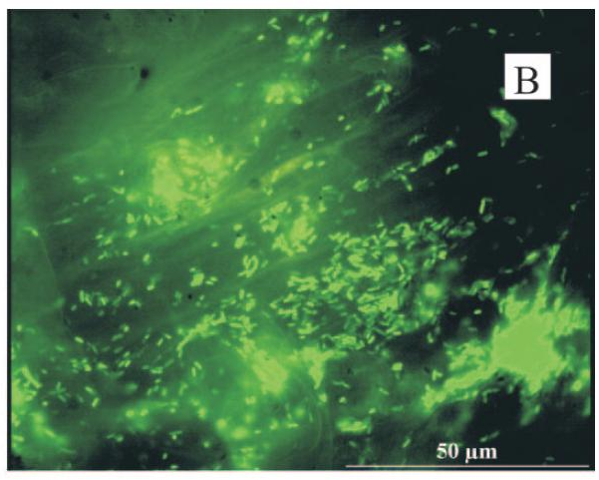
Transcription Control with P_nod
GFP reporter of nod promoter from Sinorhyizobium meliloti in P. fluorescens F113
Notes:
When they first build the pathway, the observe poor conversion. Though no evidence is provided that this lack of optimality cannot be solved by use of stronger conventional promoters, the authors take a different approach of environmentally-restricting the expression of the pathway by use of a nod promoter. They choose a promoter element from Sinorhyizobium that is known to activate when the bacteria colonizes a root nodule. Here, they place the promoter in front of GFP and show that it is also selectively induced in nodules when expressed in their chassis organism, Pseudomonas fluorescens. They then place their catabolic pathway downstream of the nod promoter and show improved conversion.

Slide 18
Draw in block form the biosynthetic devices constructed in this study
Why is the chassis chosen for these experiments Pseudomonas fluorescens F113 instead of E. coli or yeast?
Why don’t we use this organism more frequently?
Where do the genes come from, how were they identified?
Why do they switch to using a nodulation promoter instead of the native promoter for these genes?
How was the nodulation promoter chosen and identified?
How did b-galactosidase and GFP make it in to their constructs, why was it useful?
What is luteolin, and what role does it play in this study?

Slide 19
Biosynthesis of Benzylisoquinoline Alkaloids
PMID: 18690217
Notes:
The production of pharmaceutical intermediates is a key interest of metabolic engineers. The biosynthetic production of bioactive compounds is important for reducing the environmental footprint of pharmaceutical production, but it also poses biosafety and biosecurity concerns around the production of controlled substances.

Slide 20
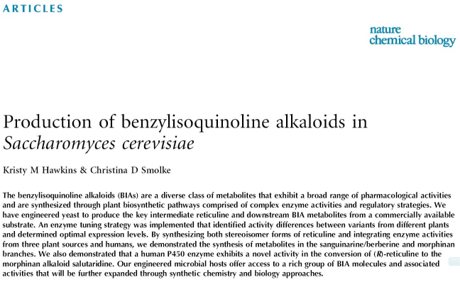
Notes:
In this study, Smoke and cowokers build biosynthetic devices to produce benzylisoquinoline alkaloids in baker’s yeast. The family of molecules includes therapies for a wide range of conditions from cancer to autoimmune disorders. It also includes some well known compounds including morphine and berberine. The complexity of molecules in this class make them difficult to produce at scale using synthetic organic chemistry. Thus, producing these important compounds in cells would greatly enable their accessibility.

Slide 21
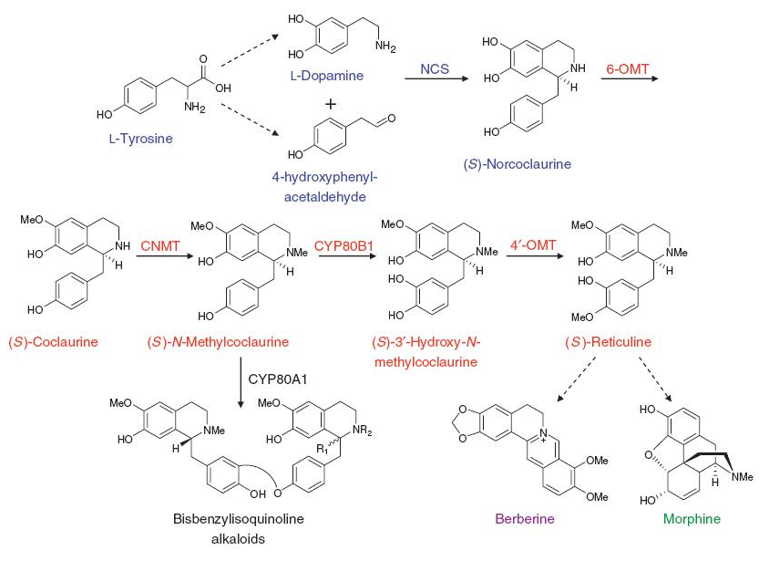
Native Pathways
Notes:
The native pathway to these chemicals begins with tyrosine. There are unknown initial steps for production of dopamine and 4-hydroxyphenyl acetaldehyde. There are also unknown terminal steps from Reticuline to the more final products like compounds like morphine and berberine. Thus, current knowledge only enables them to build a biotransformation to the key Reticuline intermediate.

Slide 22
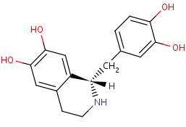
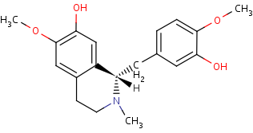
Reticuline Biotransformation
CSY288
CSY334
CSY456
(R,S)-norlaudanosoline
(S)-reticuline
Notes:
They note that a structurally-related compound, norlaudanosoline is readily available commercially, and they are able to convert this chemical to reticuline biologically by adding three methyltransferases to yeast. By optimization of the promoters in front of the methyltransferases, they optimize the conversion to this key intermediate.

Slide 23
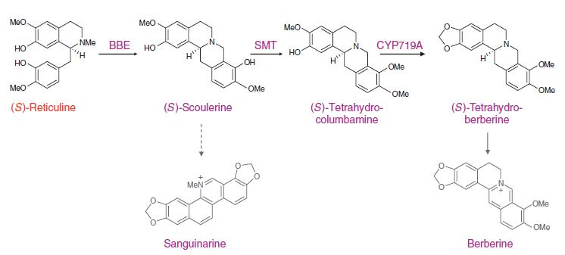
Diversification
Notes:
The incorporation of additional genes allows them to produce intermediates en route to Berberine and Sanguinarine, boxed in blue. These studies demonstrate that production of these highly active and highly valuable compounds is only limited by our ability to identify a sufficient set of enzymes needed to complete pathways.

Slide 24
Draw in block form the biosynthetic devices constructed in this study (what is added, deleted, or modified)
How were the various enzymes that they put into yeast identified?
What is the “new enzyme tuning strategy” they describe?

